Slide 1

TOPIC:
Computer Organization and Architecture
Input-Output Processor (IOP), CPU-IOP Communication
(Lectures 33)
By-
Dr. Heranmoy Maity, DICE, CUIET

Slide 2
What is Input-Output Processor (IOP)?
An input-output processor (IOP) is a processor with direct memory access capability. In this, the computer system is divided into a memory unit and number of processors. Each IOP controls and manage the input-output tasks. The IOP is similar to CPU except that it handles only the details of I/O processing.

Slide 3
Input-Output Processor (IOP)
Input Output processors (IOP) are an extension to the DMA concept of I/O Operation. As the name implies, I/O processors have some processing capacity for serving the device controllers connected to it. IOPs can decode and execute I/O instruction. These instructions are brought from Main Memory by the IOP. Data transfer happens with Memory directly. Thus an IOP has a fair amount of control over IO Operations with very minimal initiation from CPU.
IOPs are also called Peripheral Processing Unit (PPU). I/O Channels is a name used in Mainframe to mean IOP.

Slide 4
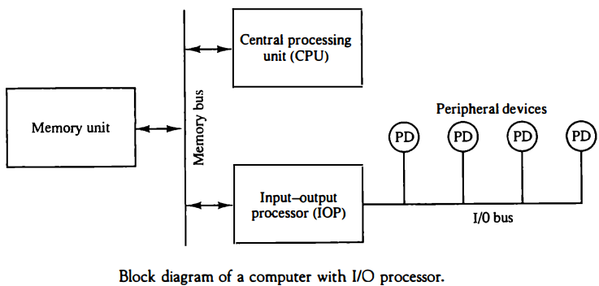
Input-Output Processor (IOP) (Cont..)

Slide 5
Working of Input-Output Processor
When an I/O device has to access or store data to memory, it requests the DMA controller. The DMA controller then sends a Hold request (HLD) to the CPU to hold.
The CPU, on receiving the Hold request, sends Hold acknowledgment (HLDA) to the DMA controller.
After receiving the HLDA, the DMA controller allows the data transfer and takes charge of the system bus.
On completion of the data transfer, the DMA again issues an interrupt, letting the CPU know that the data transfer has finished.

Slide 6
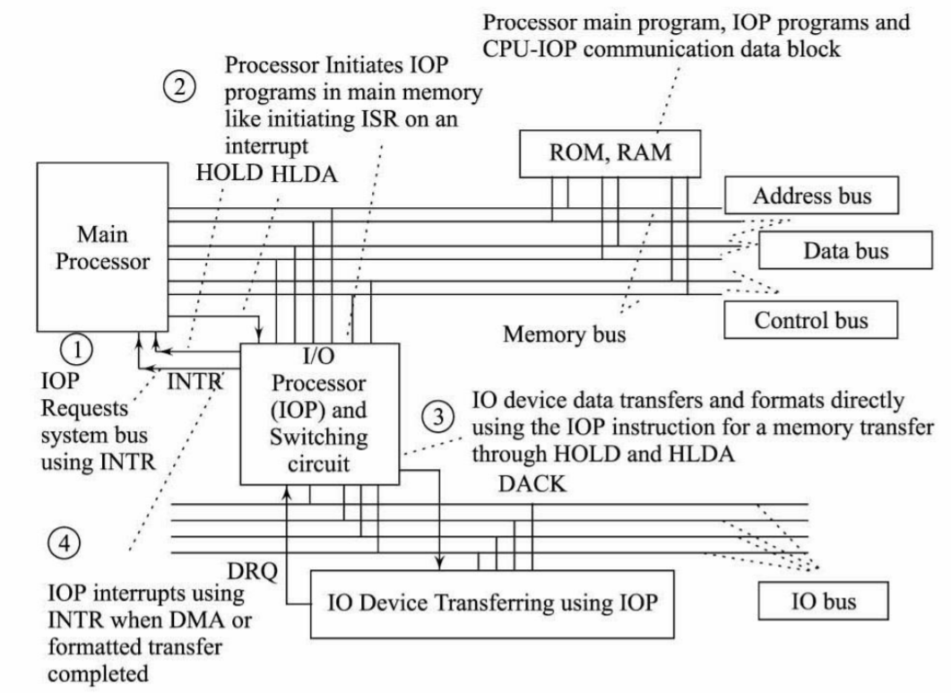
Working of Input-Output Processor (Cont..)

Slide 7
Characteristics of IOP
Has Instruction set catered to IO operations
It can execute a sequence of instructions called "I/O Program" on a device connected to it.
Ability to decode and execute IO instructions for a variety of devices. Each device has unique commands that can be executed on them.
High-Speed Data transfer to increase the IO Performance
Variety of devices can be connected
Multiplexed IOP connects slow speed device controllers
Selector IOP for high-speed device controllers
Similar to DMA channels, IOP also has channels to connect Device controllers
IOP is connected to System Bus
Possible to have more than one IOP in a system configuration

Slide 8
Functioning of IOP
IOP frees CPU from I/O data transfer operations. The CPU is involved to the extent of informing the address of the I/O program in memory. And the IOP is expected to get the IO Program, decode and execute. After the data transfer is complete, the IOP raises an Interrupt to CPU. The communication steps between CPU, IOP and Memory in completing data transfer is depicted in figure.

Slide 9
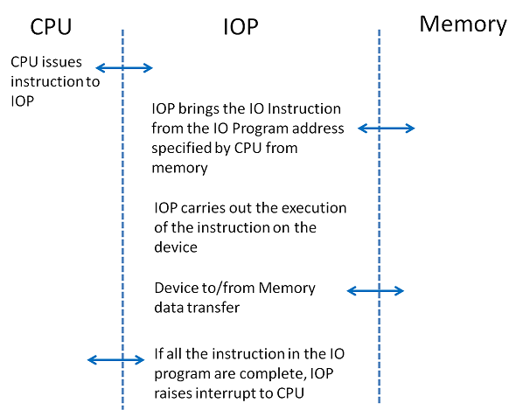
Functioning of IOP (Cont..)
The communication steps between CPU, IOP and Memory in completing data transfer is depicted in figure.
Communication steps in IOP operation

Slide 10
CPU – IOP Instruction
The instruction issued by CPU to IOP has three parts:
CPU Opcode indicating that the instruction is to instruct IOP
IO Device Address – it is the target device on which the IO program is to be executed
IO Program Address – It is a Main Memory Address where the set of commands to be executed on the IO Device is stored.
Components of CPU instruction to IOP

Slide 11
CPU – IOP Instruction (Cont..)
Components of CPU instruction to IOP
The CPU does not get involved in instructing the IO devices. Corresponding to each IO Device, an IO Program is stored in Memory. The IO program consists of a set of instructions to be executed on the device notified by the CPU Instruction to IOP.

Slide 12
Advantages of Input-Output processor
Speeds up the read-write operations as it does not involve a processor.
I/O devices can access the main memory directly.
Reduces the CPU overhead of waiting for I/O to complete.
Increases the hardware cost.
Cache coherence problem (keeping multiple local caches synchronized) can occur.
Disadvantages of Input-Output processor

Slide 13
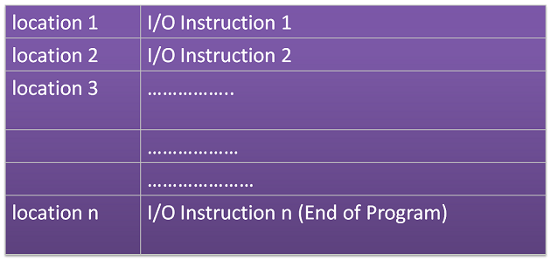
IO Program
A typical IO program is much like any other program, except that it has IO Instructions to be executed on a select device.
IO Program in Memory

Slide 14
IO Program (Cont..)
An I/O instruction received by IOP from memory as part of the IO Program has four parts as below:
IOP Instruction from Memory
IO Opcode – the IO instruction to be executed on the device
If it is a Data Transfer instruction, the memory address for data transfer. For data transfer, IOP accesses memory via the system bus. It contends on the bus based on the bus arbitration logic design.
If it is a Data Transfer instruction, the size of the data transfer – Data transfer count
Control information – how this instruction to be executed in terms off error handling, interrupts etc. and also, whether any more instructions are chained and hence follows this instruction. This is a very useful feature. IT has bits assigned to indicate End of IO Program.

Slide 15
IOP Instruction Categories
Data transfer instructions - for doing data transfer.
Branch instructions - allow the IOP to fetch the next CCW form a specified memory location instead of from the contiguous location
Arithmetic and logical instructions – facilitate the calculation of memory addresses, IO Device priorities and so on
IO Device Control instructions - These are not data transfer ones; these are transmitted to the device and specify functions peculiar to that device. Ex: seek, rewind, Top of form etc.

Slide 16
Communication channel between CPU and IOP
There is a communication channel between IOP and CPU to perform task which come under computer architecture. This channel explains the commands executed by IOP and CPU while performing some programs. The CPU do not executes the instructions but it assigns the task of initiating operations, the instructions are executed by IOP. I/O transfer is instructed by CPU. The IOP asks for CPU through interrupt. This channel starts by CPU, by giving “test IOP path” instruction to IOP and then the communication begins.

Slide 17
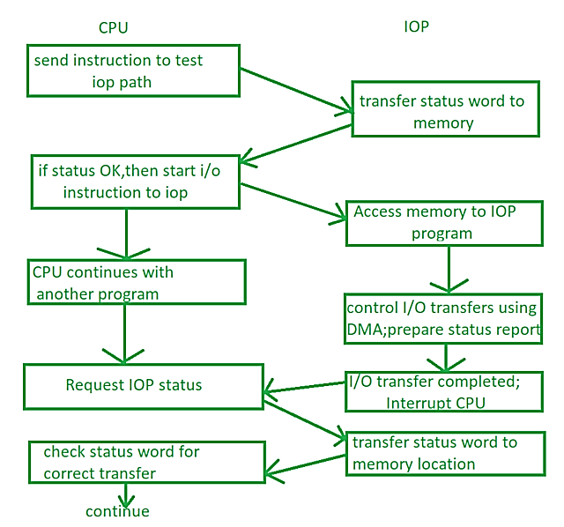
Communication channel between CPU and IOP (Cont..)
Communication channel between IOP and CPU

Slide 18
Communication channel between CPU and IOP (Cont..)
Whenever CPU gets interrupt from IOP to access memory, it sends test path instruction to IOP. IOP executes and check for status, if the status given to CPU is OK, then CPU gives start instruction to IOP and gives it some control and get back to some another (or same) program, after that IOP is able to access memory for its program. Now IOP start controlling I/O transfer using DMA and create another status report as well. AS soon as this I/O transfer completes IOP once again send interrupt to CPU, CPU again request for status of IOP, IOP check status word from memory location and gives it to CPU. Now CPU check the correctness of status and continues with the same process.

Slide 19
Thank You

